Slide 1


GENDER DETECTION
AI-FEST
Project Evaluation
Mohammad Sabih(Team Lead)
Muhammad Ahmed Siddiqui
Abdullah Mussarat
Sufyan Ahmed
Instructor: Muhammad Sheryar
Department of Computer Science - DHA Suffa University

Slide 2


Summary
Project Brief Introduction
Problem Statement
Dataset Description
Project Scope
ML/DL/NLP Model Details
Results and Discussions
Tools and Technologies Learnt During the Project Implementation (Individual Skills Set)
Project Demo
References (last accessed)
Can have
maximum 20 slides.
If you want to add any other slide other than this you can but listed heading are required.

Slide 3
Project Brief Introduction
Gender detection is a fascinating application of machine learning that aims to identify and classify the gender of individuals based on various inputs.
This project explores the implementation of machine learning algorithms to automatically predict the gender of individuals from data such as facial images.

Slide 4
Problem Statement
Develop a machine learning system capable of accurately predicting the gender (male or female) of individuals based on facial images. The project aims to explore and implement various algorithms to achieve robust gender classification, evaluating performance metrics and potential real-world applications.

Slide 5
Dataset Description
The dataset used for Gender Detection consists of
Facial Images: High-resolution images capturing facial features and expressions of individuals.
Key considerations in dataset preparation include Data Balance means maintaining a balanced distribution of male and female instances to prevent bias in model training.

Slide 6
Project Scope
The scope of a Gender Detection project in machine learning typically includes the following aspects:
Data Collection and Preparation
Feature Engineering and Selection
Model Selection and Training
Evaluation and Performance Metrics
Deployment and Application
Documentation and Reporting

Slide 7
ML/DL/NLP Model Details
The deepface library is used here, The deepface library itself utilizes pre-trained deep learning models for facial analysis:
VGG-Face: This is a deep convolutional neural network (CNN) model trained on a large dataset of faces.
ResNet:The ResNet model used in deepface is likely adapted for face recognition and gender detection tasks.
Facenet: Facenet is a deep convolutional network designed for face recognition tasks.
OpenFace: OpenFace is another deep learning model that provides facial feature extraction capabilities.

Slide 8
Results and Discussions
Gender Detection Accuracy:
Present the results of gender detection for each image in image_files. Record the accuracy of the gender predictions made by the deepface library for each image, noting correct and incorrect classifications.
Visual Representation:
Display the original images with bounding boxes around detected faces and labels indicating the predicted gender (e.g., "Male" or "Female").

Slide 9
Results and Discussions
Model Performance:
Evaluate the overall performance of the gender detection model based on the results obtained.
Impact of Data Quality:
Consider how the quality and diversity of the dataset (image_files) affect model performance.
Future Directions:
Propose potential improvements or extensions to the current gender detection model.

Slide 10
Tools and Technologies Learnt During the Project Implementation
During the implementation of a Gender Detection project using machine learning
Python: Primary programming language for implementing machine learning algorithms and data processing tasks.
OpenCV : Used for image manipulation, processing, and computer vision tasks
Version Control Systems: Such as Git, used for managing project versions, collaborating with teammates, and tracking changes in code.

Slide 11
Tools and Technologies Learnt During the Project Implementation
Development Environments: Like Jupyter Notebooks or IDEs such as VS Code, for writing and testing code, and analyzing results.
Visualization Libraries: Such as Matplotlib or Seaborn, used for visualizing data distributions, model performance metrics, and results.

Slide 12
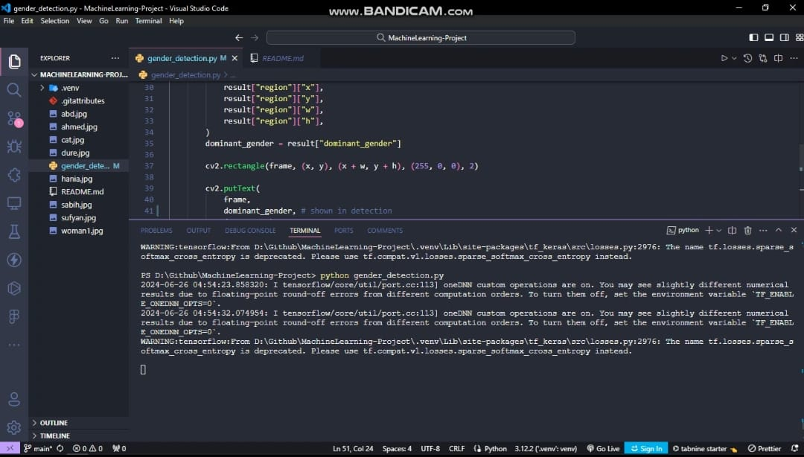
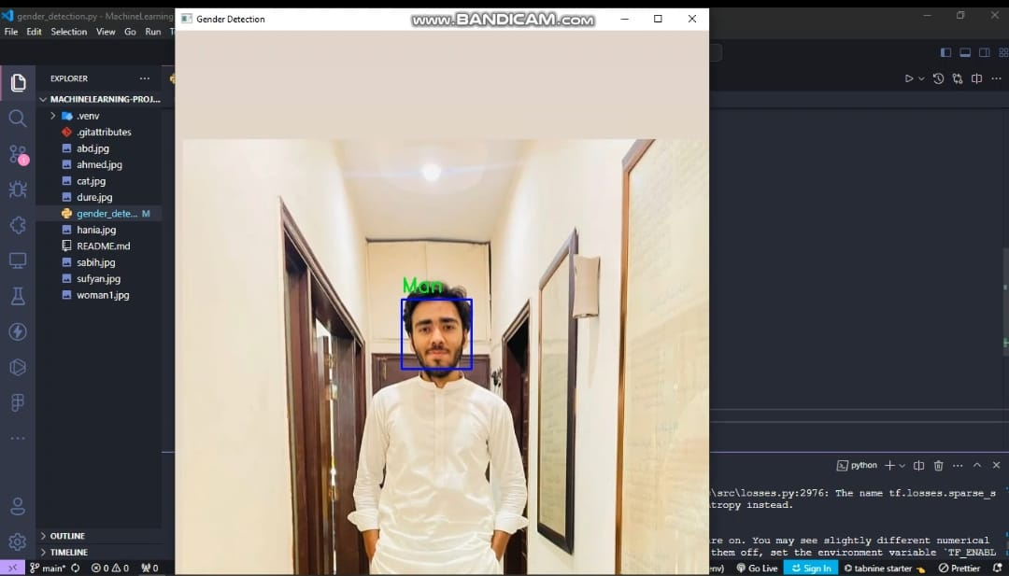
Project Demo

